Slide 1
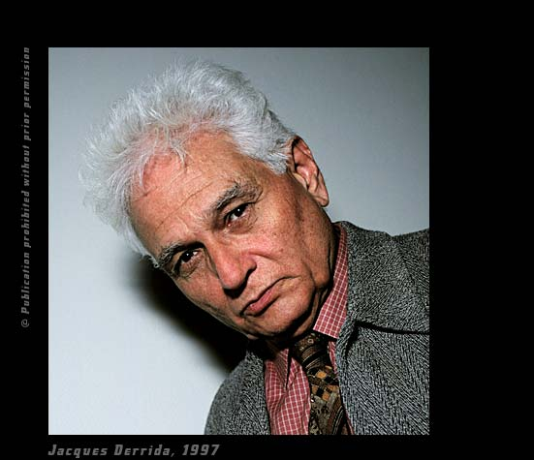
Lecture Eight: Derrida

Slide 2
Deconstruction
Deconstruction can be understood as a certain way of reading texts, particularly philosophical texts, in order to uncover their aporias – in other words, their internal moments of self-contradiction and tension.
Eg. In Dissemination (1981): Derrida discusses the way that in Plato’s thought writing is secondary to speech. Speech is seen as immediate and authentic, whereas writing is a kind of corruption of this is because it does not require the immediate presence of addressor and addressee.
However, Derrida shows that in Plato’s text Phaedrus where he privileges speech over writing, he can only do so by using the metaphor of writing to talk about speech: in other words, he ends up describing speech as a kind of writing itself. So here writing forms a kind of dangerous supplement to speech which contaminates its identity.
Furthermore, this subordination of writing to speech has been central to Western philosophy and forms its logocentric structure: it presupposes a kind of presence (eg speech) which is more immediate and authentic, more real than the thing that represents it (writing). But if speech can be seen as simply another form of writing, then this jeopardises this idea of an immediate presence and authenticity.
Derrida wants to suggest that all central identities and binary divisions in philosophy are never pure and self-identical. They are always contaminated by what something else beyond their structures.

Slide 3
Derrida’s politico-ethical figures: the Decision
Decisions are central to politics. Yet if we simply follow an absolute moral law (ie Kantian categorical imperative) then we are not really making an ethical decision – we would be simply automatons without ethical responsibility for our decisions. If you carry out some ethical obligation simply because it is a moral law then you are not acting as an ethical subject – there is no free ethical choice here, just the application of the law.
So ethics cannot be the simple application of a rule or the realization of a norm, because this obscures the trial of undecidability which every ethical decision must experience.
The ethical decision is a moment of madness – a kind of leap into the unknown, without absolute guarantees: indeed, the ethical moment can be seen precisely in this gap that exists between the decision and the normative order. It always implies a risk.

Slide 4
Derrida’s politico-ethical figures: Justice
The law is the mere application of a rule; whereas justice must go through the ordeal of undecidability. Justice forms a kind of internal limit to the structure of law: it is what opens law to the other, to alterity, to the singularity of the decision that it cannot account for.
While law is the application of the rule, justice is what continually reinvents the rule by applying it in different and unpredictable ways.
The law itself is based on a founding violence, which is both disavowed and, yet, enacted each time the law is applied. This is what Derrida refers to as the ‘mystical foundations of authority’: its absence of legitimate foundations.
Derrida is not saying we should abolish the law, but we need to subject it to a kind of constant questioning of its self-certainty – by exposing its ultimate arbitrariness.
Justice, in this sense that it goes beyond the structures of the law, is infinitely perfectible; justice is always ‘to come’, an event that “exceeds calculation, rules, programs, anticipations...”.

Slide 5
Derrida’s politico-ethical figures: Human rights
Derrida actually insists on unconditional rights – against the contemporary retreat from human rights: “We must (il faut) more than ever stand on the side of human rights. We need (il faut) human rights.”
However, Derrida also seeks to free the understanding of human rights from their traditional foundations in Enlightenment rationalist ideas about a universal human nature. A deconstructive approach reveals the historicity of human rights.
The supposed universality of human rights has been based on a series of discursive exclusions: traditionally, women, children, non-Western ‘barbarians’, the mentally ill etc, had been deprived of human rights in classical liberal discourse. By unmasking these exclusions, a deconstructive approach actually forces human rights to live up to their own promise of universality: it allows human rights to be continue to be extended, as they have been historically, to a whole a series of previously excluded identities.
In this way, human rights are infinitely perfectible and always ‘to come’.

Slide 6
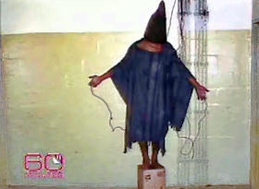
Abu Ghraib

Slide 7
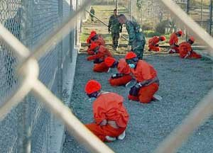
GITMO

Slide 8
Derrida’s politico-ethical figures: Hospitality
Derrida invokes the Kantian cosmopolitan tradition – and central here is the concept of hospitality. For Kant, hospitality is not only a universal right but also an obligation.
However Derrida explores some of the aporias in this notion of hospitality: hospitality affirms the idea that one is master of one’s house to which one welcomes the stranger – hospitality is thus always conditional on the will of the master > in other words, if I welcome a guest into my house I also expect him to abide by certain conditions and rules that I establish.
However this is antithetical to the true understanding of hospitality: hospitality implies an unconditional right of the stranger, and an unconditional obligation placed on the master of the house, such that this position of mastery – of guarding the threshold and determining the conditions of the stranger’s entry – is itself thrown into question. In other words, to be truly hospitable we must welcome the stranger without any conditions, and take the risk that he may turn out to be a bad guest – but this is the ethical risk we must take.
Applies this notion to the position of asylum seekers and refugees - idea of ‘cities of refuge’ beyond the control of the nation state.

Slide 9
Derrida’s politico-ethical figures: Democracy to Come (avenir)
Autoimmunity: what is unique about democracy as a political regime is its capacity for self-criticism – democracy presupposes an open polity and even has a suicidal quality – a tendency towards self-destruction.
  a) anti-democratic forces using the democratic system to get into power – eg the 1992 elections in Algeria or the National Front in France in 2002.
  b) the way that governments, in the name of protecting and securing their democracies from outside terrorist forces that threaten it, introduce measures and laws which undermine democracy from within.
  Both examples show the fragility of democracy and the fundamental risk of leaving itself open to those who challenge it. However, for democracy to be democracy it must take this risk – to try to immunize democracy against such challenges itself destroys it.
Democracy to come: an unforseen event which comes from the outside, but at the same time emerges from within the radical potential of democracy itself, urging democracy to live up to its own promise, its own perfectibility.
  Democracy always points to a horizon beyond, to the future; it is always ‘to come’. It is for this reason that it is impossible. But this means we should never be satisfied with existing forms taken by democracy and we should always be working towards its perfectibility.

Slide 10
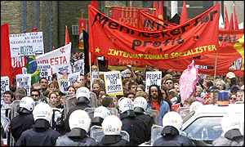
Democracy to come: movement for global democracy.

